Slide 1
Meiosis & Introduction to Genetics
Chapter 13 (p.248-260)
Chapter 14 (p.262-269)

Slide 2
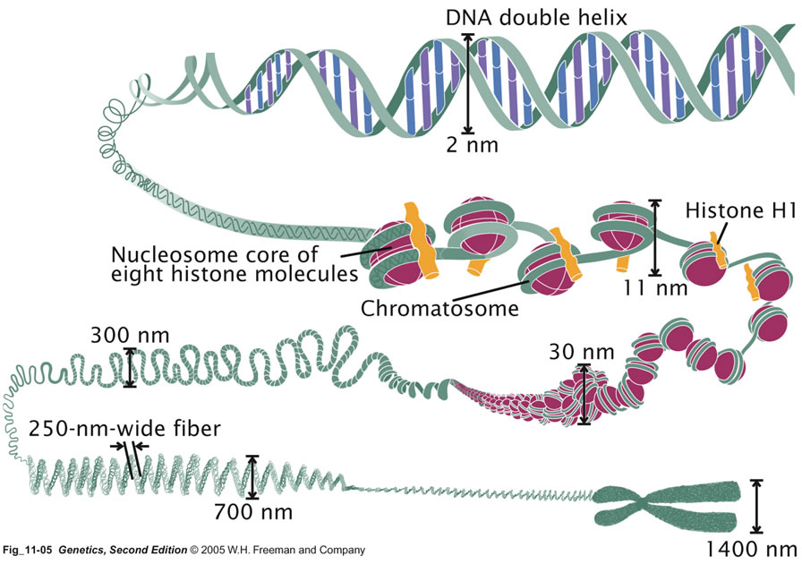
Chromosomes

Slide 3
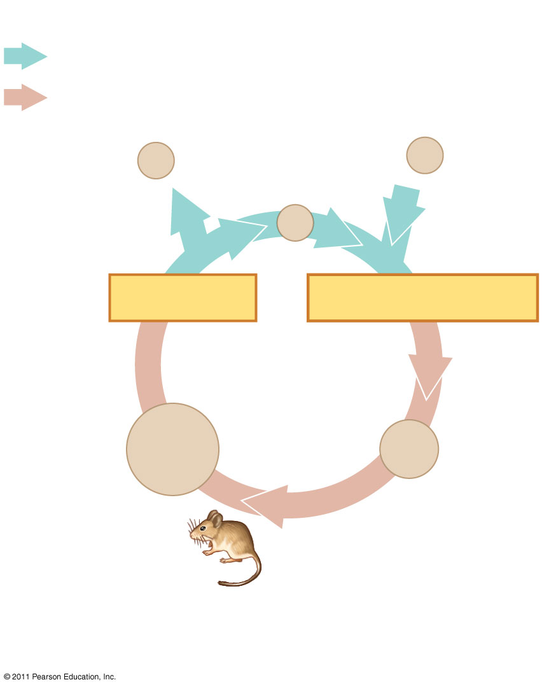
Key
Haploid (n)
Diploid (2n)
n
Gametes
n
n
MEIOSIS
FERTILIZATION
2n
Zygote
2n
Diploid multicellular organism
Mitosis
(a) Animals
Notes:
Figure 13.6 Three types of sexual life cycles.

Slide 4
Chromosomes

Slide 5
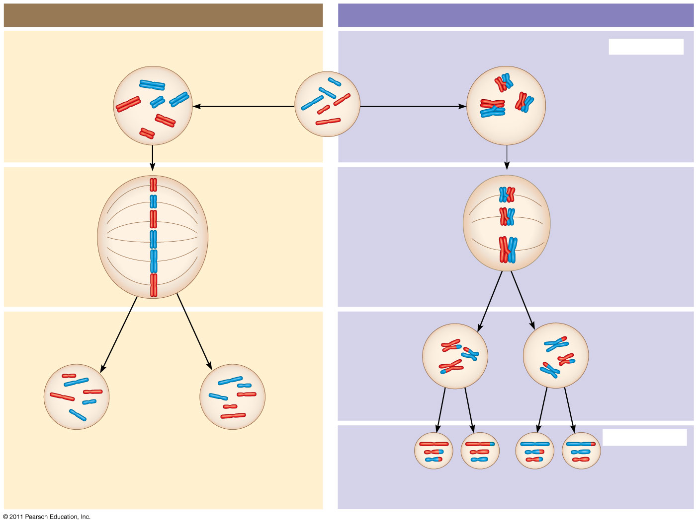
MITOSIS
MEIOSIS
Parent cell
MEIOSIS I
Prophase
Prophase I
Replication
Replication
Homologous chromosome pair
Metaphase
Metaphase I
Anaphase Telophase
Anaphase I
Telophase I
MEIOSIS II
Notes:
Figure 13.9 A comparison of mitosis and meiosis in diploid cells.

Slide 6
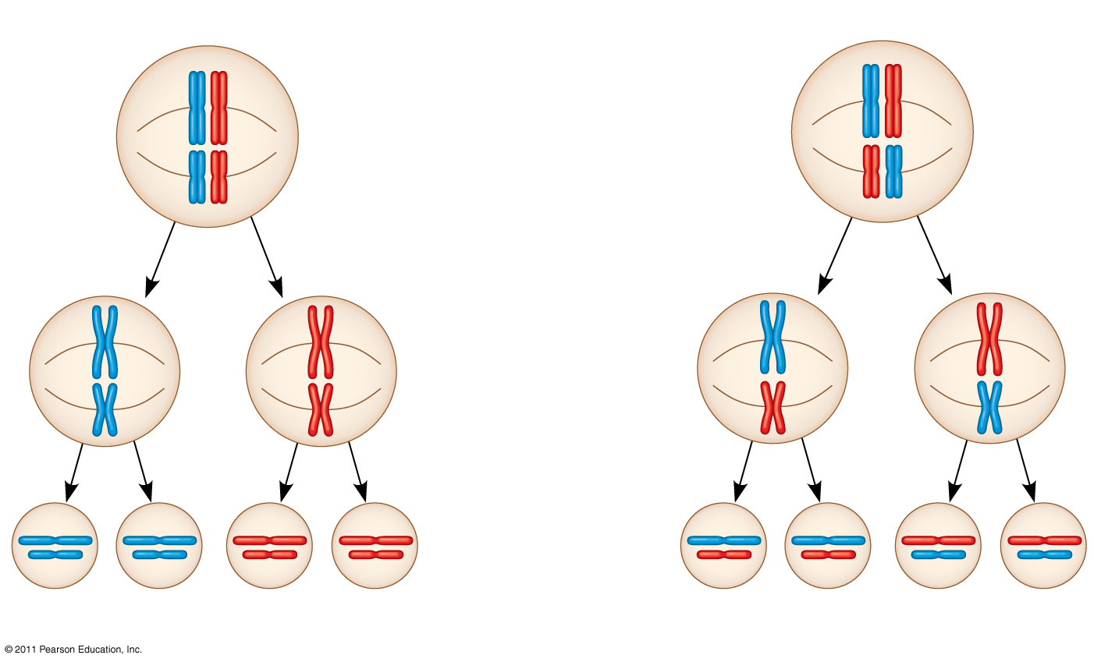
Possibility 1
Possibility 2
Metaphase I
Metaphase II
Daughter cells
Combination 1
Combination 2
Combination 3
Combination 4
Notes:
Figure 13.10 The independent assortment of homologous chromosomes in meiosis.

Slide 7
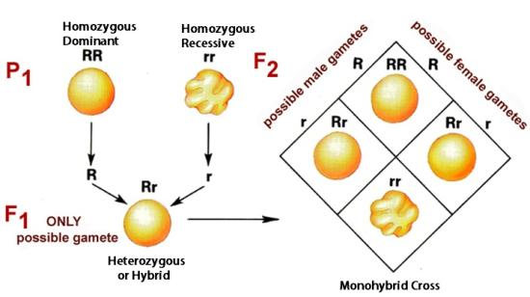

Slide 8
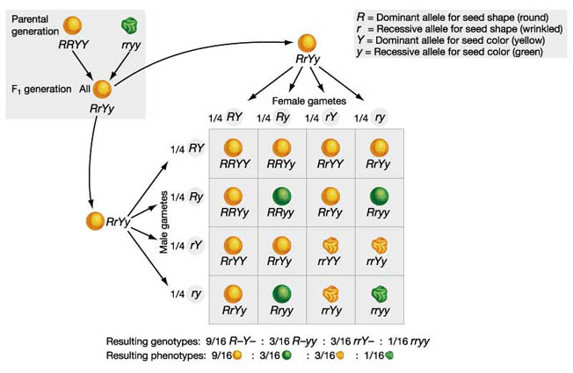

Slide 9
Mendel’s Model
Alternate versions of genes (called alleles) account for inherited characteristics.
For each character, an organism inherits 2 alleles (one from mother, one from father).
If two alleles at a locus differ, the dominant determines the phenotype. The recessive allele has no noticeable effect.
LAW OF SEGREGATION: The two alleles for a heritable character separate from one another and end up in different gametes.
LAW OF INDEPENDENT ASSORTMENT: Each pair of alleles segregates independently from other pairs of alleles during gamete formation.

